Slide 1
Distributed Machine Learning
Yue Wang

Slide 2
Outline
Overview of distributed machine learning
Implementation of DML
Some detail discussion
Notes:
ADMM
SGD
SCD
SVRG
SDCA

Slide 3
Overview of distributed machine learning
Why distributed machine learning
How distributed machine learning
Some potential problem

Slide 4
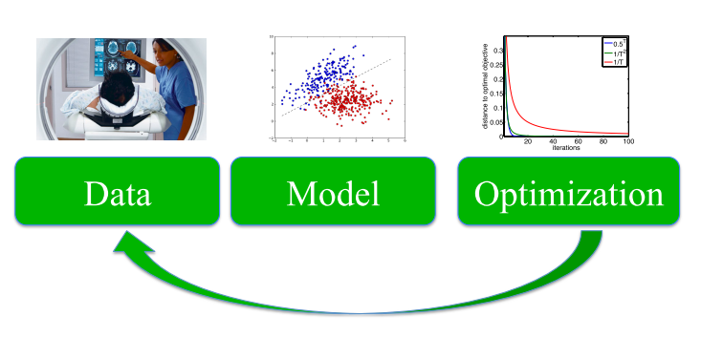
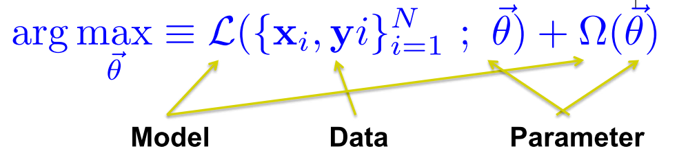
Overview of distributed machine learning
Why distributed machine learning
More data
More complex model
Speed

Slide 5
Overview of distributed machine learning
How distributed machine learning
Notes:
1 并行化的视角
2 异步算法的实现
3 并行算法遇到的问题

Slide 6
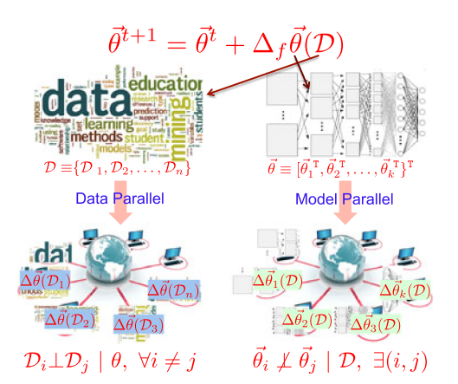
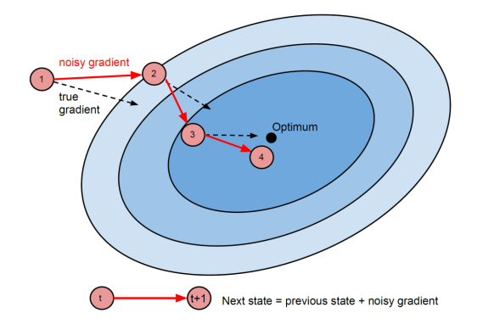
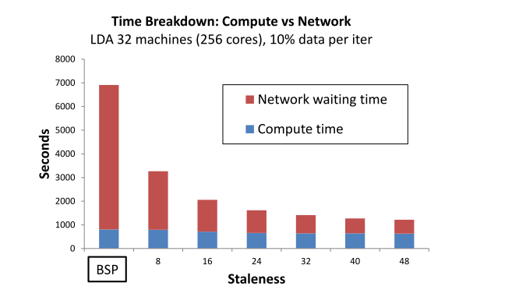
Overview of distributed machine learning
Some potential problem
Convergence
Communication cost
Data and parameter distributed

Slide 7
Implementation of DML
SGD
Synchronous SGD
Cyclic asynchronous SGD
Lock-free asynchronous SGD(hogwild!)
Downpour SGD
Stale Synchronous Parallel Parameter Server
Elastic averaging SGD
Others

Slide 8
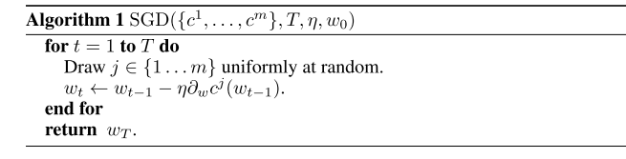
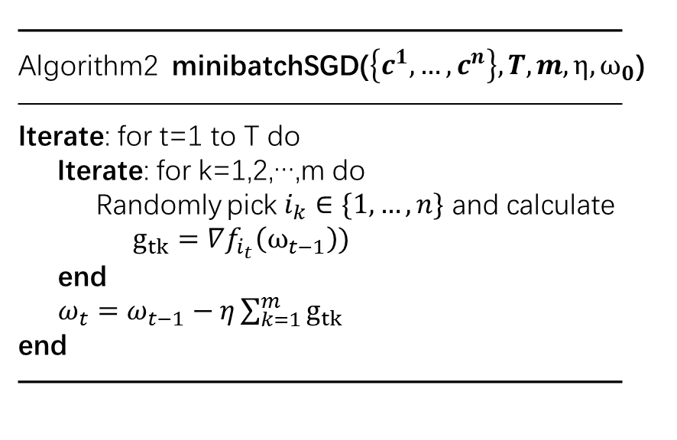
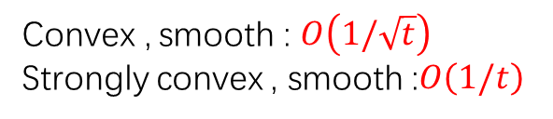
SGD
Advantage(compare to GD)：
Disadvantage
Consider minibatchSGD
—————————————————————
Algorithm2 minibatchSGD($\left\{c^{1},…,c^{n}\right\},T,m,η,ω_{0}$)
—————————————————————
Iterate: for t=1 to T do
Iterate: for k=1,2,…,m do
Randomly pick $i_{k}∈\{1,…,n\}$ and calculate $g_{tk}=∇f_{i_{t}}\left(ω_{t−1}\right))$
end
$ω_{t}=ω_{t−1}−η\sum_{k=1}^{m}{g_{tk}}$
end
—————————————————————
Convex , smooth : $O\left(1/\sqrt{t}\right)$
Strongly convex , smooth :$O\left(1/t\right)$

Slide 9
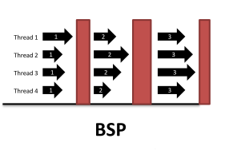
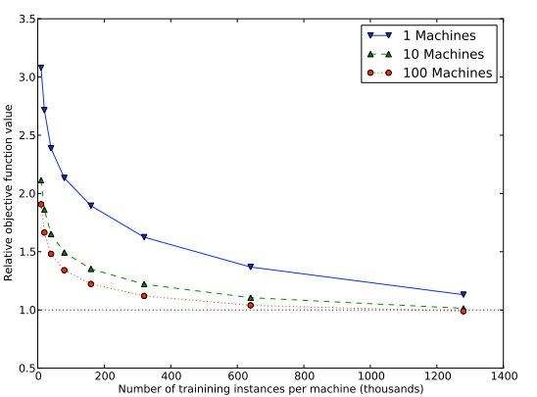
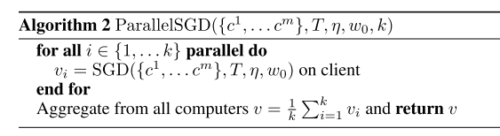
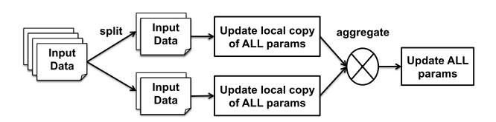
Synchronous SGD
Consider :
If a worker failed
Notes:
Data partition
T<<m

Slide 10
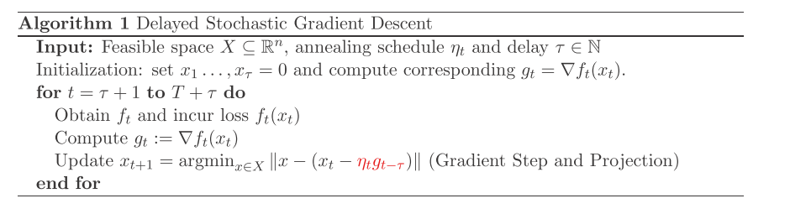
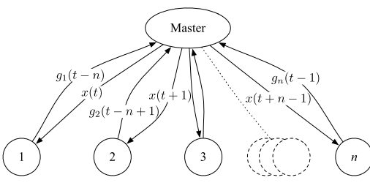
Cyclic asynchronous SGD
Notes:
Online
Data partition

Slide 11
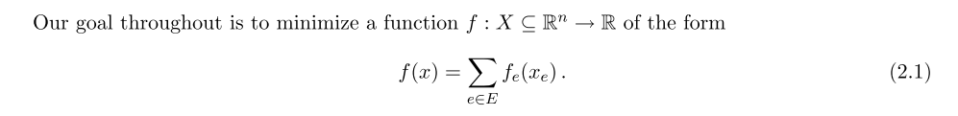

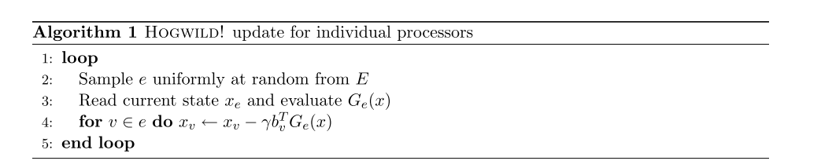
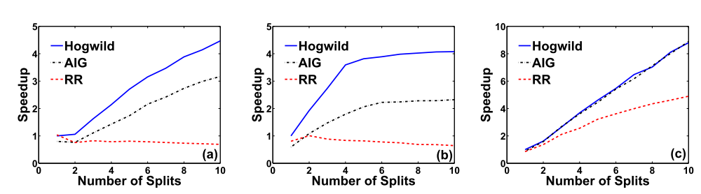
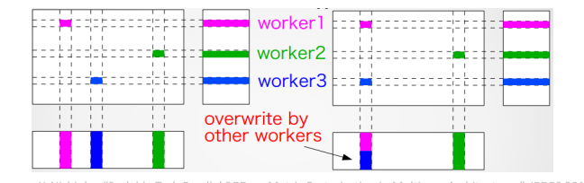
Lock-free asynchronous SGD(hogwild!)
Notes:
单机share memory

Slide 12
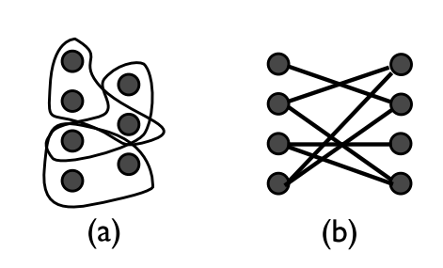
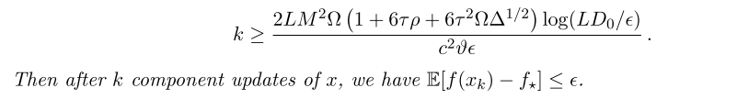
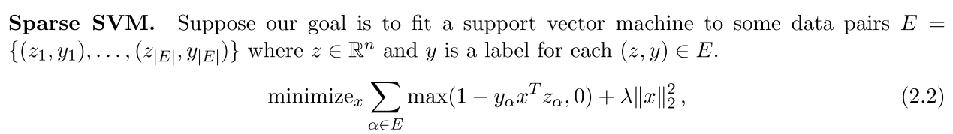
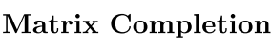
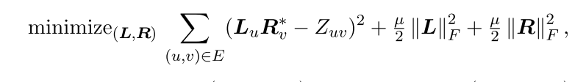
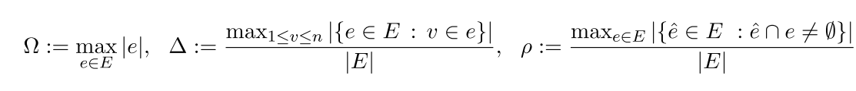

Slide 13
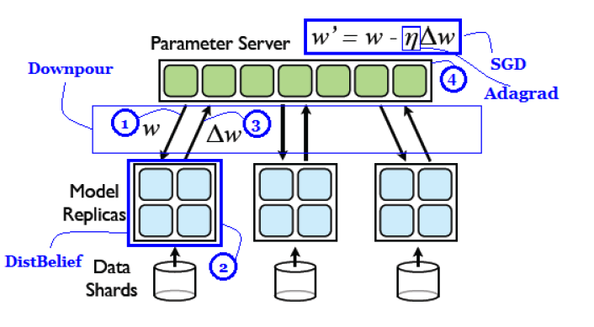
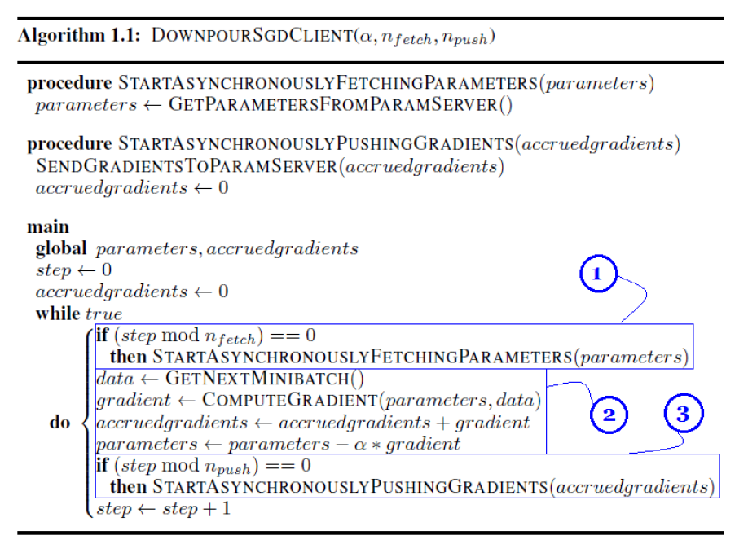
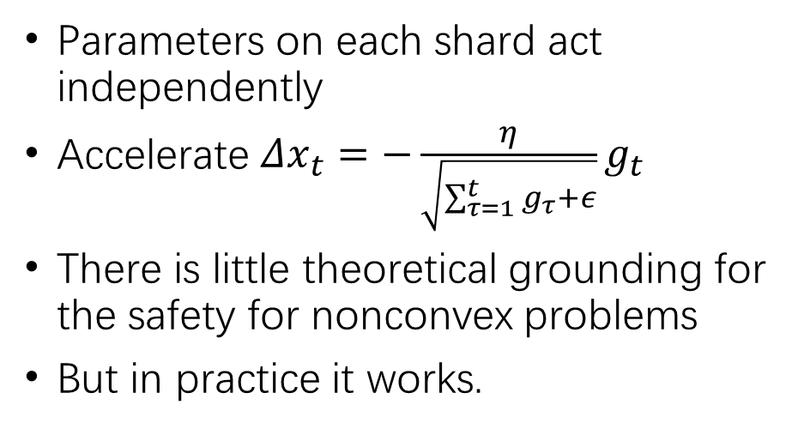
Downpour SGD
Parameters on each shard act independently
Accelerate $Δx_{t}=−\frac{η}{\sqrt{\sum_{τ=1}^{t}{g_{τ}}+ε}}g_{t}$
There is little theoretical grounding for the safety for nonconvex problems
But in practice it works.
Notes:
Data parallelism

Slide 14
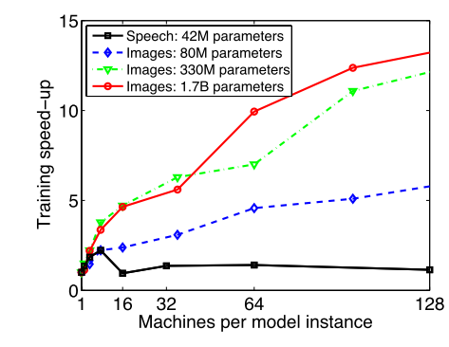
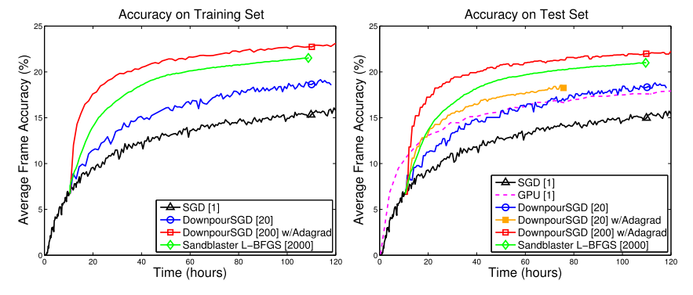

Slide 15
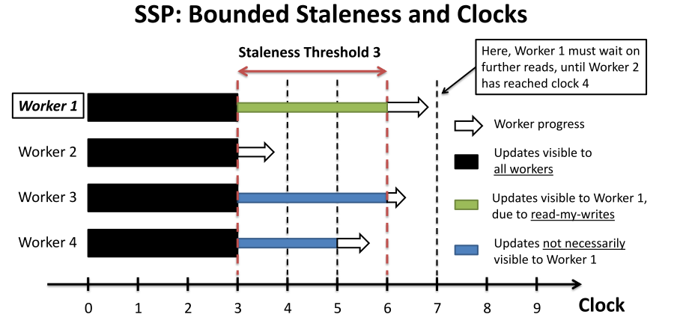
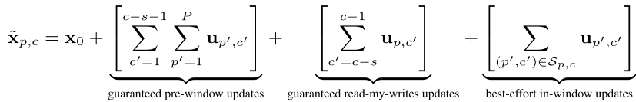
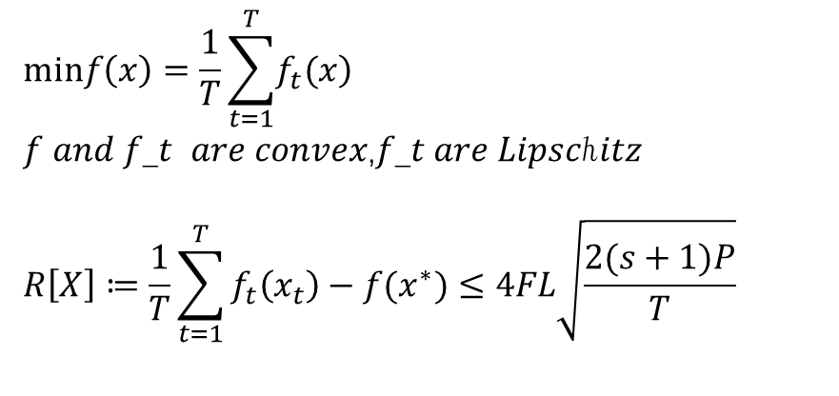
Stale Synchronous Parallel Parameter Server
C ： current clock
S ： the max delay between slowest and fastest workers
Guaranteed : [0,c-s-1]
Adaptive : [c-s,c+s-1]
$$minf\left(x\right)=\frac{1}{T}\sum_{t=1}^{T}{\left.f_{t}(x\right)}$$
𝑓 𝑎𝑛𝑑 𝑓_𝑡 𝑎𝑟𝑒 𝑐𝑜𝑛𝑣𝑒𝑥,𝑓_𝑡 𝑎𝑟𝑒 𝐿𝑖𝑝𝑠𝑐ℎ𝑖𝑡𝑧
$$R\left[X\right]≔\frac{1}{T}\sum_{t=1}^{T}{f_{t}\left(x_{t}\right)−f(x^{∗})}≤4FL\sqrt{\frac{2(s+1)P}{T}}$$

Slide 16
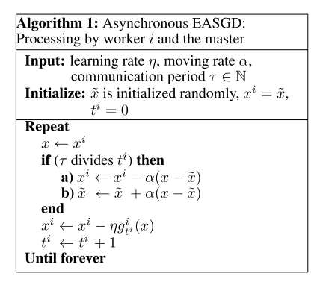
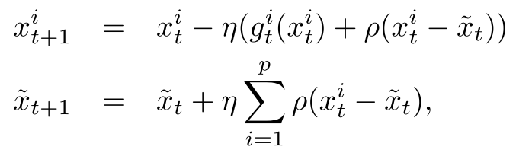
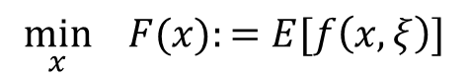
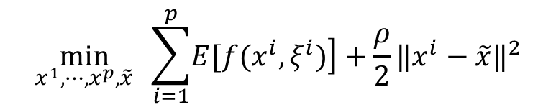
Elastic averaging SGD
$$\min_{x} F(x):=E[f\left(x,ξ\right)]$$
$$\min_{x^{1},⋯,x^{p},\tilde{x}} \sum_{i=1}^{p}{\left.E[f(x^{i},ξ^{i})\right]}+\frac{ρ}{2}{‖x^{i}−\tilde{x}‖}^{2}$$

Slide 17
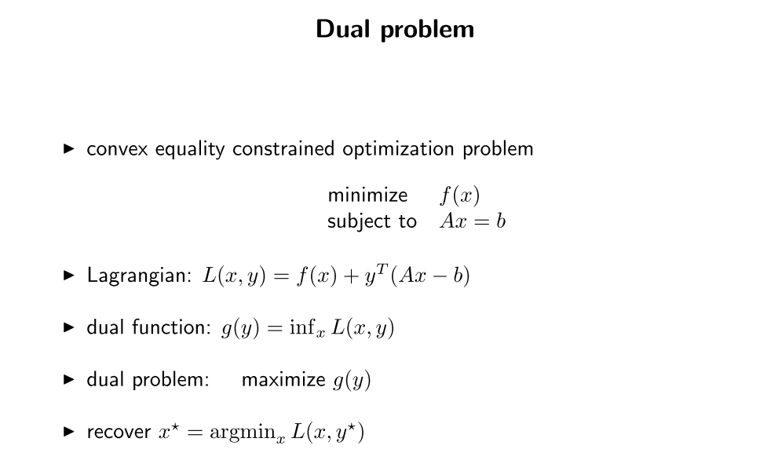
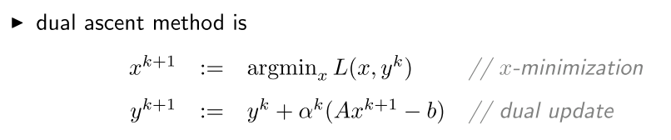

Slide 18
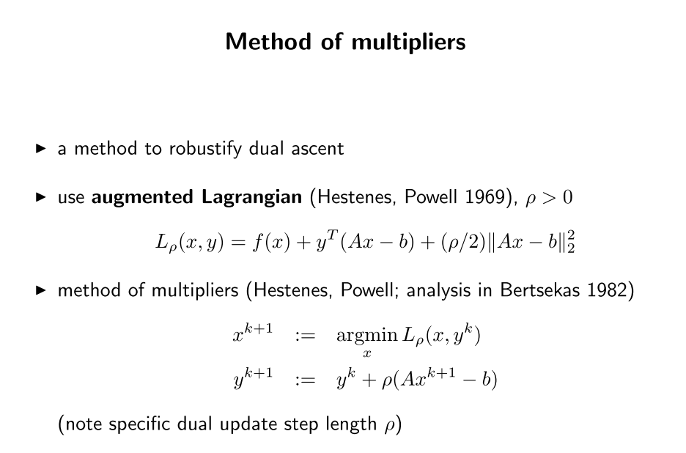

Slide 19
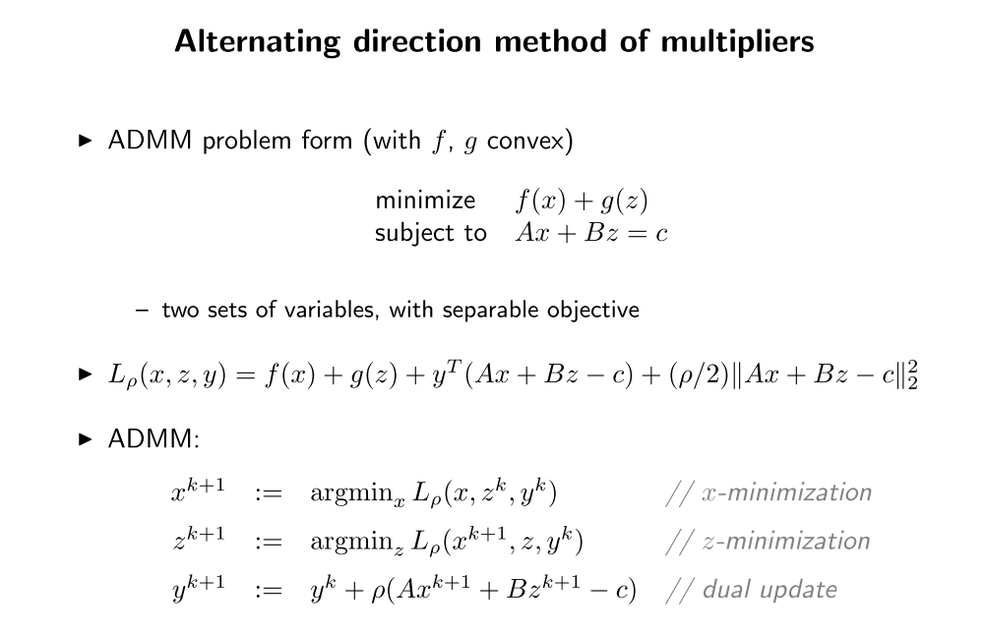

Slide 20
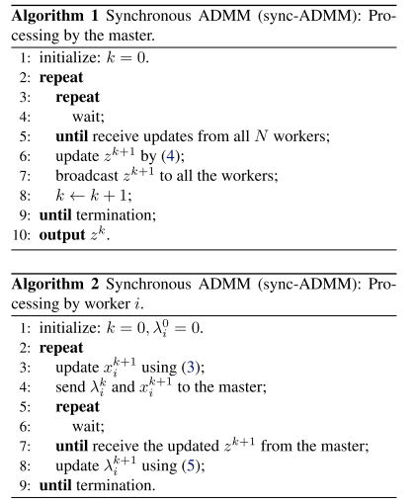
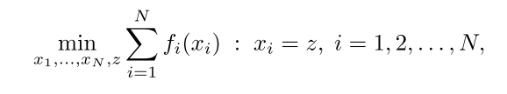
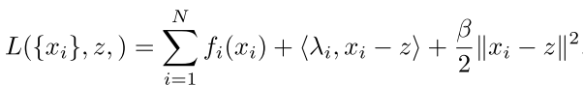
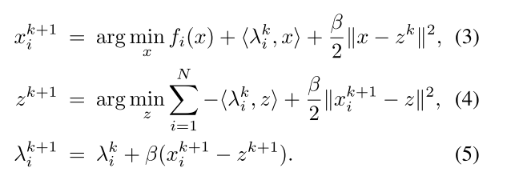
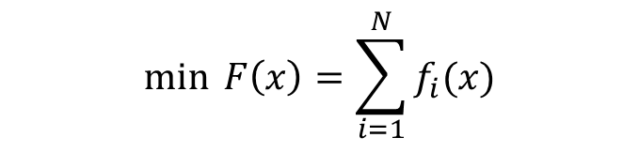
Others(ADMM)
$$\min{F\left(x\right)=\sum_{i=1}^{N}{f_{i}(x)}}$$

Slide 21
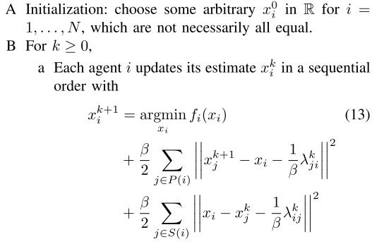
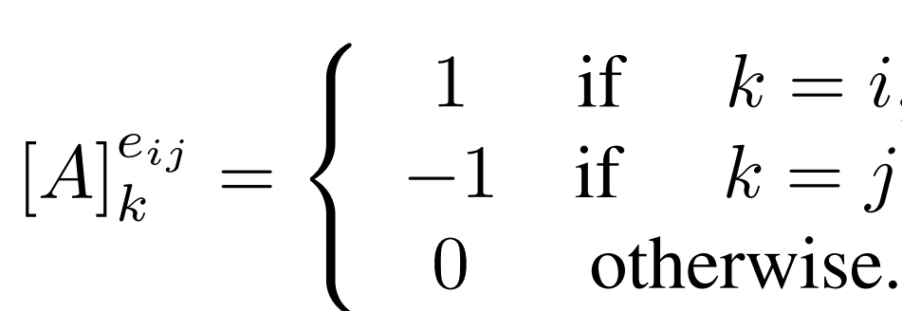
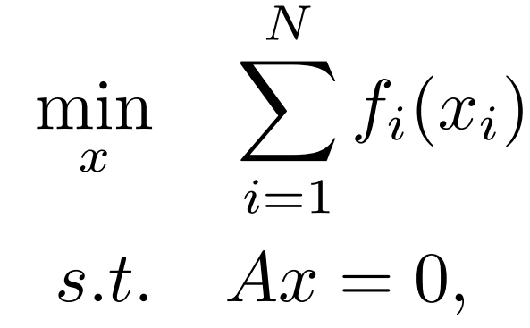
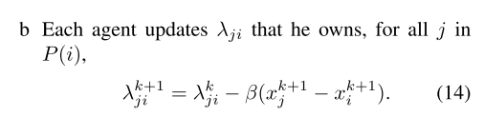
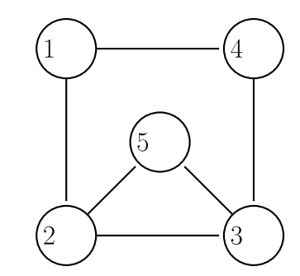


Others(ADMM decentralize)
$$\min{F\left(x\right)=\sum_{i=1}^{N}{f_{i}(x)}}$$

Slide 22



Others（SVRG）
Notes:
n data number

Slide 23
Some detail discussion
The effect of distributed
Tradeoff between computation and communication
Model Parallelism and data parallelism

Slide 24




Some definition
Regret bond $R[X]:=\sum_{t=1}^{T}{(\left.f_{t}(x_{t})−f_{t}(x^{∗}\right))}$
Expectation bond $ε=E\left[\left.f(x^{t})−f(x^{∗}\right)\right]$
High probability bound $\left.p((x_{t}−x^{∗})>ε\right)$
For nonconvex $\left.E({‖\left.∇f(x_{k}\right)‖}^{2}\right)$
Convergence rate $\frac{x_{k+1}−L}{x_{k}−L}=μ_{k}$
$μ_{k}→1$ sublinearly
$μ_{k}→μ$ $0<μ<1$ linearly
$μ_{k}→0$ superlinearly

Slide 25

Different implementation | Delay bound | Convergence | Assumpution | Setp size
Cyclic delay SGD | $$τ<\sqrt{T}$$ | $$R[X] ≤4FL\sqrt{\left(τT\right)}$$ | Lipschitz | $$η_{t}=\frac{σ}{\sqrt{t−τ}}$$
 |  | $$R[x]≤λτF^{2}+[\frac{1}{2}+τ]\frac{L^{2}}{λ}(1+τ+logT)=O(logT)$$ | strongly convex | $$η_{t}=\frac{1}{\left.λ(t−τ\right)}$$
Hogwild! | $$τ<O{(n}^{\frac{1}{4}})$$ | $$k≥\frac{\left.2LM^{2}Ω(1+6τρ+6τ^{2}ΩΔ^{1/2})log(L{D_{0}}/ε\right)}{c^{2}θε}$$ | strongly convex Lipschitz | $$η=$$ $$\frac{θε\text{c}}{\left.2LM^{2}Ω(1+6ρτ+4τ^{2}ΩΔ^{\left(1/2\right)}\right)}$$
ssp |  | $$R[X]≤4FL\sqrt{2(s+1)PT}$$ | Convex lipschitz | $$η_{t}=\frac{σ}{\sqrt{t}}$$
AsySGD con | $τ$< O($\sqrt{K/M}$) | $$\frac{1}{K}\sum_{k=1}^{K}{\left.E({‖\left.∇f(x_{k}\right)‖}^{2}\right)}≤4\sqrt{\left(f(x_{1})−f(x^{∗}))L/MK\right.}σ$$ | Nonconvex Lipschitz Bounded variance | $$η_{t}=\sqrt{\left.f(x_{1})−f(x^{∗})/(MKLσ^{2}\right)}$$
AsySGD incon | $$\begin{aligned}τ< \\ O(\sqrt{K})\end{aligned}$$ | $$\frac{1}{K}\sum_{k=1}^{K}{\left.E({‖\left.∇f(x_{k}\right)‖}^{2}\right)}≤\sqrt{72\left(f(x_{1})−f(x^{∗})){Ln}/MK\right.}σ$$ | Nonconvex Lipschitz Bounded variance | $$η_{t}=$$ $$\sqrt{2(\left.f(x_{1})−f(x^{∗}{))n}/(MKLσ\right)}$$
Notes:
tau delay
T 总迭代次数
M 梯度的界
c 强凸系数
(nonconvex)K总迭代次数
M每次迭代样本数
n参数维度

Slide 26



Slide 27


Different Implementation | Delay bound | Convergence | Assumpution | Setp size
AsySCD | $$τ≤\frac{\sqrt{n}L_{max}}{2eL_{res}}$$ | $$\left.E(f(x_{j})−f^{∗})≤{\left(1−\frac{l}{2nL_{max}}\right)}^{j}(f(x_{0})−f^{∗}\right)$$ | Strongly convex | $$γ<\frac{\left(ρ−1)\sqrt{n}L_{max}\right.}{L_{res}ρ^{τ}(2+\frac{L_{res}}{\sqrt{n}L_{max}}}$$
 | $$τ≤\frac{\sqrt{n}L_{max}}{2eL_{res}}$$ | $$E(f(x_{j})−f^{∗})≤\frac{1}{\frac{j}{4nL_{max}R^{2}}+{\left(f(x_{0})−f^{∗}\right)}^{−1}}$$ | convex
async-svrg |  | $$\left.E[f(x^{k})−f(x^{∗})]≤{\tilde{θ}}^{k}[f(x^{0})−f(x^{∗})\right]$$ | Smooth Strongly convex | $$η=\frac{0.1}{\left.2(max\{1,Δ^{1/2}τ\}L\right)}$$ $$\frac{L}{λ}=n$$ $θ$= 0.5

Slide 28


Different implementation | Delay bound | Convergence | Assumpution | Setp size
dec-ADMM |  | 0$≤L(y^{k},λ^{∗})−L(x^{∗},λ^{∗})≤\frac{1}{k}\left(\frac{1}{2β}{‖λ^{0}−λ^{∗}‖}^{2}−\frac{β}{2}{‖\left.B(x^{0}−x^{∗}\right)‖}^{2}\right)$ | convex
Async-ADMM |  | $$E[\sum_{i=1}^{N}{f_{i}(\overline{x_{i}})−f_{i}(x^{∗})+<λ_{i}^{∗},\overline{x_{i}}−\overline{z}>}]≤\frac{Nτ}{2TS}\left\{C\right\}$$ | convex
DisDCA |  | $$\left.T≥(\frac{n}{mK}+\frac{1}{λγ})log((\frac{n}{mK}+\frac{1}{λγ})\frac{1}{ε}\right)$$ | smooth
 |  | $$T≥\frac{4L^{2}}{λε}+T_{0}+\frac{n}{mK}$$ | lipschitz
DDA | $$\left.τ(ε)=\frac{C_{h}^{2}}{ε^{2}}(\frac{1}{n}+\frac{kr}{h}\right)$$ |  | Lipschitz convex

Slide 29







$$f(ω)=\frac{1}{n}\sum_{i=1}^{n}{\left.f_{i}(ω\right)}=\frac{1}{n}\sum_{i=1}^{n}{\left.f(ω:z_{i}\right)}$$
objective function
SGD
Momentum
Staleness
Asynchronous SGD
Assumpution
Conclusion
$$\left.ω_{t+1}=ω_{t}−α_{t}∇_{ω}f(ω_{t};z_{i_{t}}\right)$$
$$\left.ω_{t+1}−ω_{t}=μ_{L}(ω_{t}−ω_{t−1})−α_{t}∇_{ω}f(ω_{t};z_{i_{t}}\right)$$
$$v_{t}=ω_{t−l} w.p. q_{l} l∈N$$
$$\begin{matrix} \\ \left.ω_{t+1}=ω_{t}−α_{t}∇_{w}f(v_{t};z_{i_{t}}\right)\end{matrix}$$
$q_{l}=(1−μ_{s})μ_{s}^{l}$ geometrically distribution
$$\left.E[ω_{t+1}−ω_{t}]=μ_{S}E[ω_{t}−ω_{t−1}]−α_{t}E∇_{ω}f(ω_{t}\right)$$

Slide 30



Tradeoff between computation and communication
DisDCA | synchronous | $$\left.T≥(\frac{n}{mK}+\frac{1}{λγ})log((\frac{n}{mK}+\frac{1}{λγ})\frac{1}{ε}\right)$$ | $1/γ$ smooth | $$\left.λ=Θ(n^{\left.−1/(1+τ\right)}\right)$$
Fix the number processes K
$$Communication cost∝T=Ω\left(\frac{n}{mK}+\frac{n^{1/1+τ}}{γ}\right)$$
$$Computation cost∝mT=Ω\left(\frac{n}{K}+\frac{mn^{1/1+τ}}{γ}\right)$$
When $m<Θ\left(\frac{n^{τ/1+τ}}{K}\right)$ the communication cost decreases as m increases, and the computation costs increases as m increases
When $m>Θ\left(\frac{n^{τ/1+τ}}{K}\right)$ increasing the value of m will become less influential on reducing the communication cost; while the computation cost would blow up
Notes:
T 总迭代次数
n data数 m每次选出的data数 lambda

Slide 31




Tradeoff between computation and communication
DisDCA | synchronous update | $$\left.T≥(\frac{n}{mK}+\frac{1}{λγ})log((\frac{n}{mK}+\frac{1}{λγ})\frac{1}{ε}\right)$$ | $1/γ$ smooth | $$\left.λ=Θ(n^{\left.−1/(1+τ\right)}\right)$$
Fix the number of samples m
$$Communication cost∝Ω\left(\frac{n}{m}+\frac{{Kn}^{1/1+τ}}{γ}\right)$$
$$Computation cost∝Ω\left(\frac{n}{K}+\frac{mn^{1/1+τ}}{γ}\right)$$
When K$<Θ\left(\frac{n^{τ/1+τ}}{m}\right)$ as K increases the computation cost would decrease and the communication cost would increase
When $K>Θ\left(\frac{n^{τ/1+τ}}{m}\right)$ the effect of increasing K on reducing the computation cost would diminish.
Notes:
T 总迭代次数
n data数 m每次选出的data数 lambda
tau

Slide 32







Tradeoff between computation and communication
Async-ADMM |  | $$E[\sum_{i=1}^{N}{f_{i}(\overline{x_{i}})−f_{i}(x^{∗})+<λ_{i}^{∗},\overline{x_{i}}−\overline{z}>}]≤\frac{Nτ}{2TS}\left\{C\right\}$$ | convex
ADMM： $\min_{x}f\left(x\right)=f_{1}\left(x_{1}\right)+…+f_{M}(x_{M})$
subject to $x_{i}−z=0, i=1,…,M$
$$\left.O(\frac{Nτ}{TS}\right)$$
When N(the number of workers ) is large
When S(the minimum number of updates to wait) is large
When $τ$(the maximum number of delay) is large

Slide 33






Tradeoff between computation and communication
DDA | $$\left.τ(ε)=\frac{C_{h}^{2}}{ε^{2}}(\frac{1}{n}+\frac{kr}{h}\right)$$ | Lipschitz convex
$$τ(ε)=O\left(\frac{ah+b\frac{1}{h}}{nε^{2}}\right)$$
$$h_{opt}=\sqrt{\frac{nkr}{18 +\frac{12}{1−\sqrt{λ_{2}}}}}$$
Notes:
K 邻居数
r 信息传递时间
n 处理器数量
h 每h次自己迭代交流一次

Slide 34
Model and data parallel
Data parallel :
1. assume all data are iid.
2. online learning
Model parallel :
1. cann’t assume all data are iid
2. use “schedule”to control model parallel

Slide 35
Data parallel
Key to the validity of additivity of updates from different workers is the notion of independent and identically distributed (iid) data, which is assumed for many ML programs, and implies that each parallel worker contributes “equally” (in a statistical sense) to the ML algorithm’s progress , no matter which data subset it uses.
【 Xing E P, Ho Q, Dai W, et al. Petuum: A new platform for distributed machine learning on big data[J]. IEEE Transactions on Big Data, 2015, 1(2): 49-67 】
“however, if T is much less than m, then it is only necessary for a machine to have access to the data it actually touches.”
【Zinkevich, Martin, et al. "Parallelized stochastic gradient descent." Advances in neural information processing systems. 2010.】
SSP does not require static partitioning; dynamic strategies for load balancing are possible, and will likely improve algorithm performance further.
【Ho, Qirong, et al. "More effective distributed ml via a stale synchronous parallel parameter server." Advances in neural information processing systems. 2013..】

Slide 36



model parallel
DistBelief
STRADS
Petuum

Slide 37




Block-Greedy Coordinate Descent
B, the total number of feature blocks
P, the size of the random subset of the B blocks that is chosen at every time step
Block-Greedy Coordinate Descent |  | $$E[f(w_{k})−f(w^{∗})]≤C\frac{BR_{1}^{2}}{\left(1−ε)P\right.}\frac{1}{k}$$ | smooth separable convex | $$ε=\frac{\left(P−1)(ρ_{block}−1\right)}{\left(B−1\right)}<1$$ $\left.ρ_{block}=max（ρ(XX^{T}\right)$）
Notes:
The intuition is that if features from different blocks are almost 正交 then the matrices M in M will be close to identity and will therefore have small ρ(M).

Slide 38






Model parallel lasso
$$min f=\frac{1}{2}{‖y−Xβ‖}_{2}^{2}+λ\sum_{j}{|β_{j}|}$$
$$∇_{β}f={\text{X}}^{T}(y−Xβ)+\text{sign}\text{(}β\text{)}λ$$
Coordinate Descent |  | $$E\left[f\left(w_{k}\right)−f\left(w^{∗}\right)\right]≤\frac{Cdβ}{\left.E(P(1−ε)\right)}\frac{1}{k}$$ | smooth separable convex | $$ε=\frac{E\left(P−1)(ρ_{}−1\right)}{d}<1$$
Notes:
d feature number
P coordinates are updated in every iteration.
Rho 谱半径（特征值绝对值的最大值）

Slide 39






1
 | 2
 |  | 3
 | 1
 |  | 2
3
 |  | 1
2
 | 3
1
 | 2
 |  | 3
 | 1
 |  | 2
3
 |  | 1
2
 | 3

Slide 40
Summary
Something not covered: Boost
MCMC
…

Slide 41
THANKS

